Slide 1
Your Field Guide to SUMMER CAMP 2023
Notes:
Welcome to our 2nd camp information Webinar, I’m ____________ and we’re about to get started

Slide 2
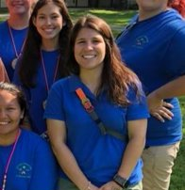
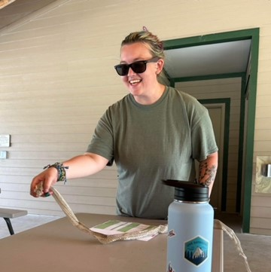
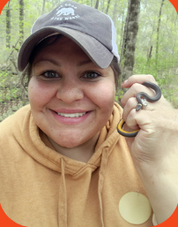
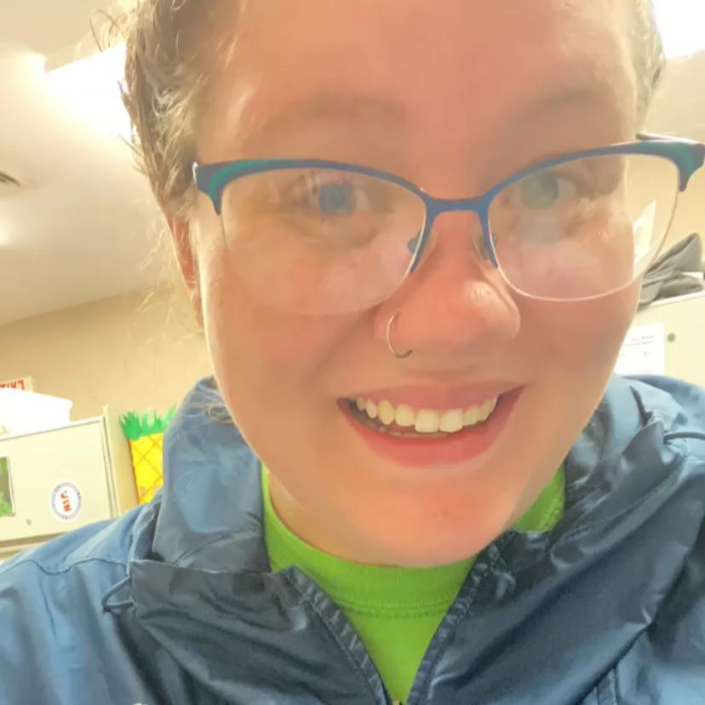
The Outdoor Program Team
Tori “Ember” Hinojosa-Houck
Fearless Leader
Mackenzie "Luna" Dumas
Camp Director – Butterworth Day Camp
Chelsea “Dandy” Smith
Camp Director – Troop Adventure Camp
Allison “Poptart” Beaupry
Seasonal Overnight Camp Director
Notes:
Before we jump into the agenda We’re going to introduce ourselves and the rest of the team that isn’t able to be on today. I’m _______________ and I direct ________________ at ________________ and I’m _____________________________. Allison isn’t able to join today but she directs overnight camp at Libbey and Whip Poor Will and Tori helps support the three of us.

Slide 3
Our Camp Programs
CampDoc
Prepping for Camper for Camp
Packing for Camp
Q&A
Agenda
Notes:
Today we’re going to do a brief recap of our camp programs and properties, talk about CampDoc.com – our online “paperwork” submission, discuss some strategies for setting your camper up for a successful camp experience and how to pack for camp then have time for Q & A

Slide 4
Our Camp Properties
Notes:
Chelsea
Many of you are probably already signed up for camp, but if you’re still debating or wanting a little more info about each camp property lets recap our camp properties and the programs we run at each
​
​

Slide 5
Our Camps
Camp Libbey​
Defiance, OH​
Overnight Camp​
Troop Adventure Camp
Camp Stonybrook​
Waynesville , OH​
Troop Adventure Camp​
Camp Whip Poor Will​
Morrow, OH​
Overnight Camp​
Camp Butterworth ​
Maineville, OH​
Day Camp
Notes:
​Chelsea
We host our summer camp opportunities at 4 of our camp properties across the council. ​Each camp is ACA Accredited.
First we have Camp Libbey, located in Defiance which is about an hour west of Toledo, and we host overnight and troop adventure camp there.​
Next, Camp Stonybrook is in Waynesville and is home to troop adventure camp for the majority of the summer.
Camp Whip Poor Will is located outside of Morrow and offers 5 weeks of overnight camp. ​
And then we have Camp Butterworth in Maineville, which is near Cincinnati, and it has 8 weeks of day camp.​
We host camp open houses at each of these camps at the beginning of the summer – you and your camper can attend to get a feel for what the camp looks like and meet some of the camp staff. We will share the open house dates for each camp as we learn more about each one.
Now that you have an idea of where our camps are located, let's talk more about each type of camp we offer.

Slide 6
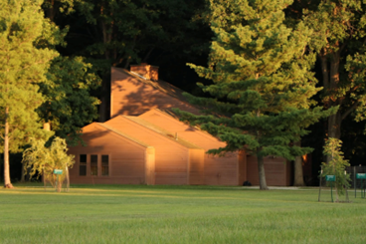
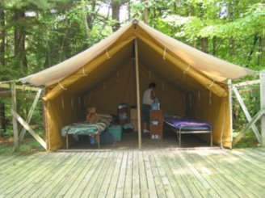
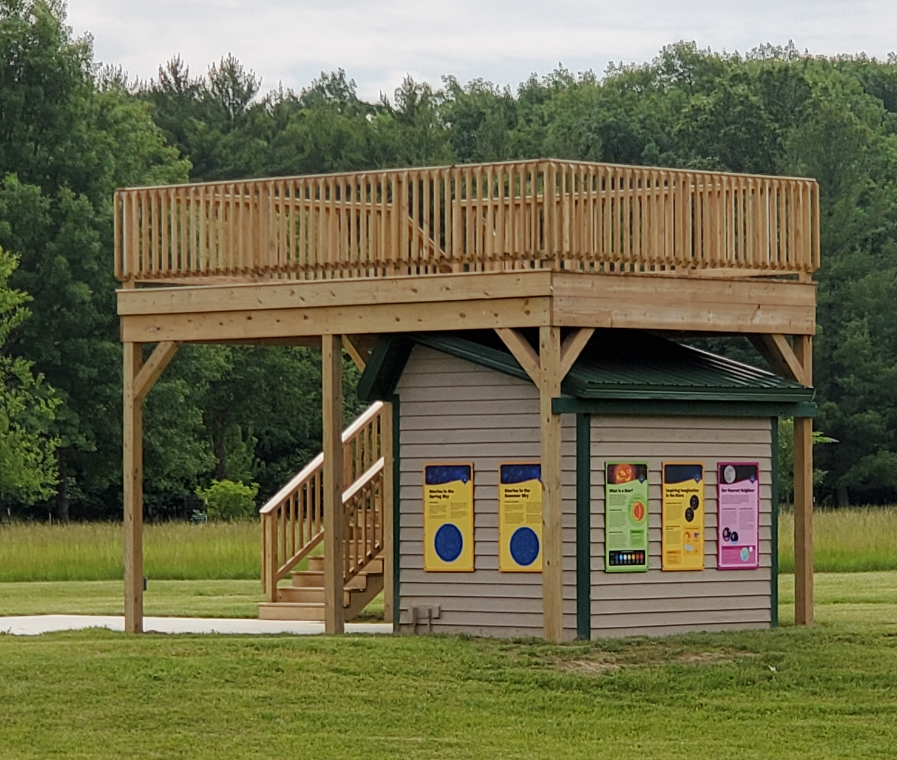
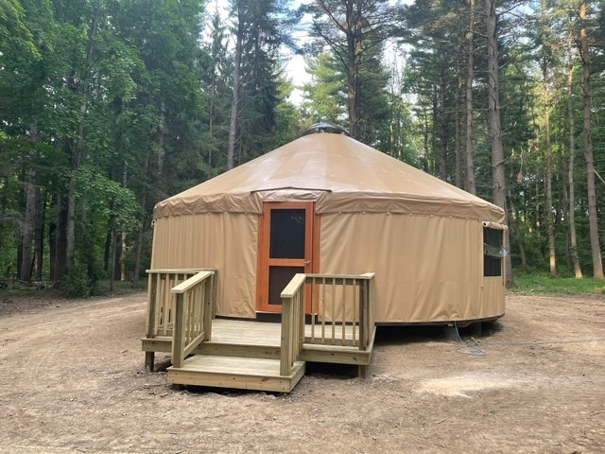
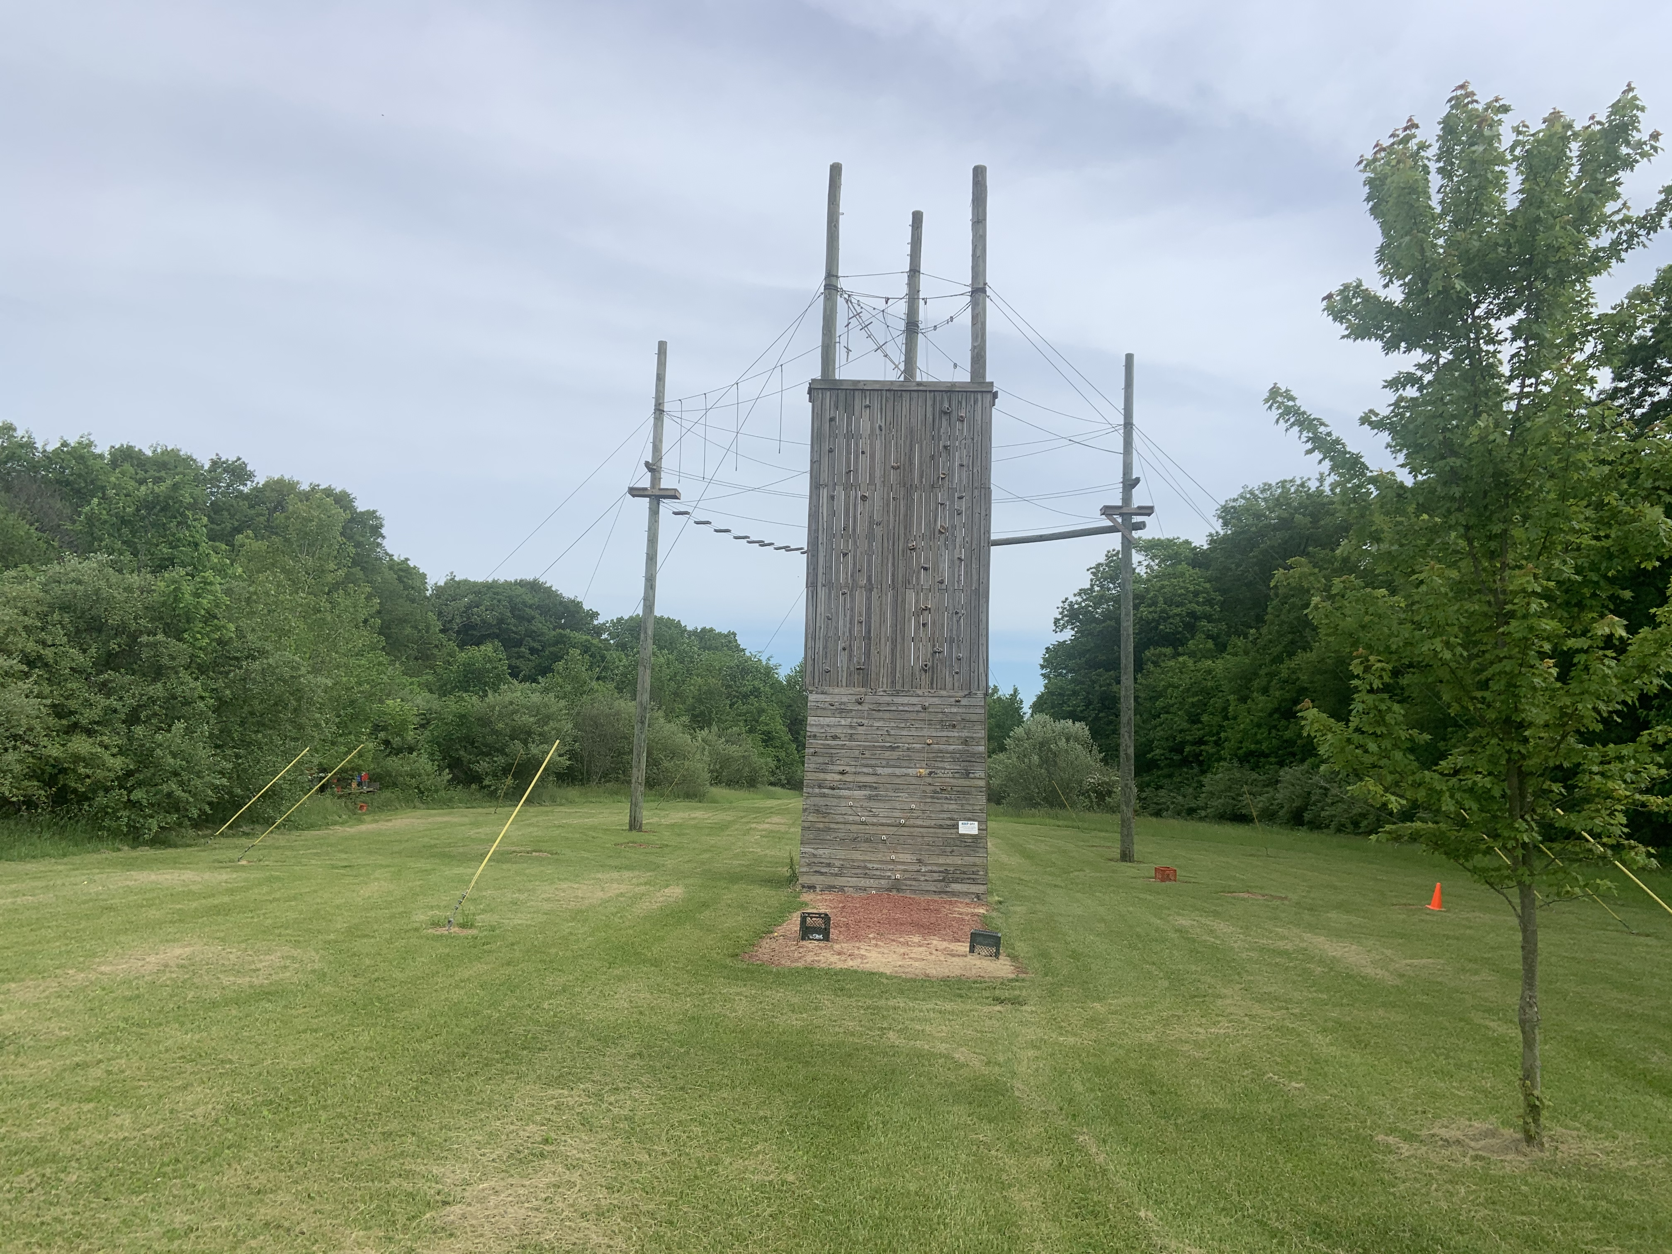
Camp Libbey
Open House
May 25
1-3pm
Defiance, OH
All units have flushing toilets and showers in unit
Accommodations: lodges, tents, cabins and yurt
Has a climbing wall, high and low challenge course, target sports barn, sky deck, pool, creek and more
Notes:
Chelsea
Camp Libbey is in Defiance, it'll be the second year that the TAC team is running it up at Libbey for 3 sessions
Libbey is typically not described as rustic, it has flushing bathrooms in all units, not just the lodges
Libbey features a climbing wall, high and low challenge course, target sports barn, sky deck, pool, creek and more!
The Open House at Camp Libbey is May 25 from 1-3pm

Slide 7
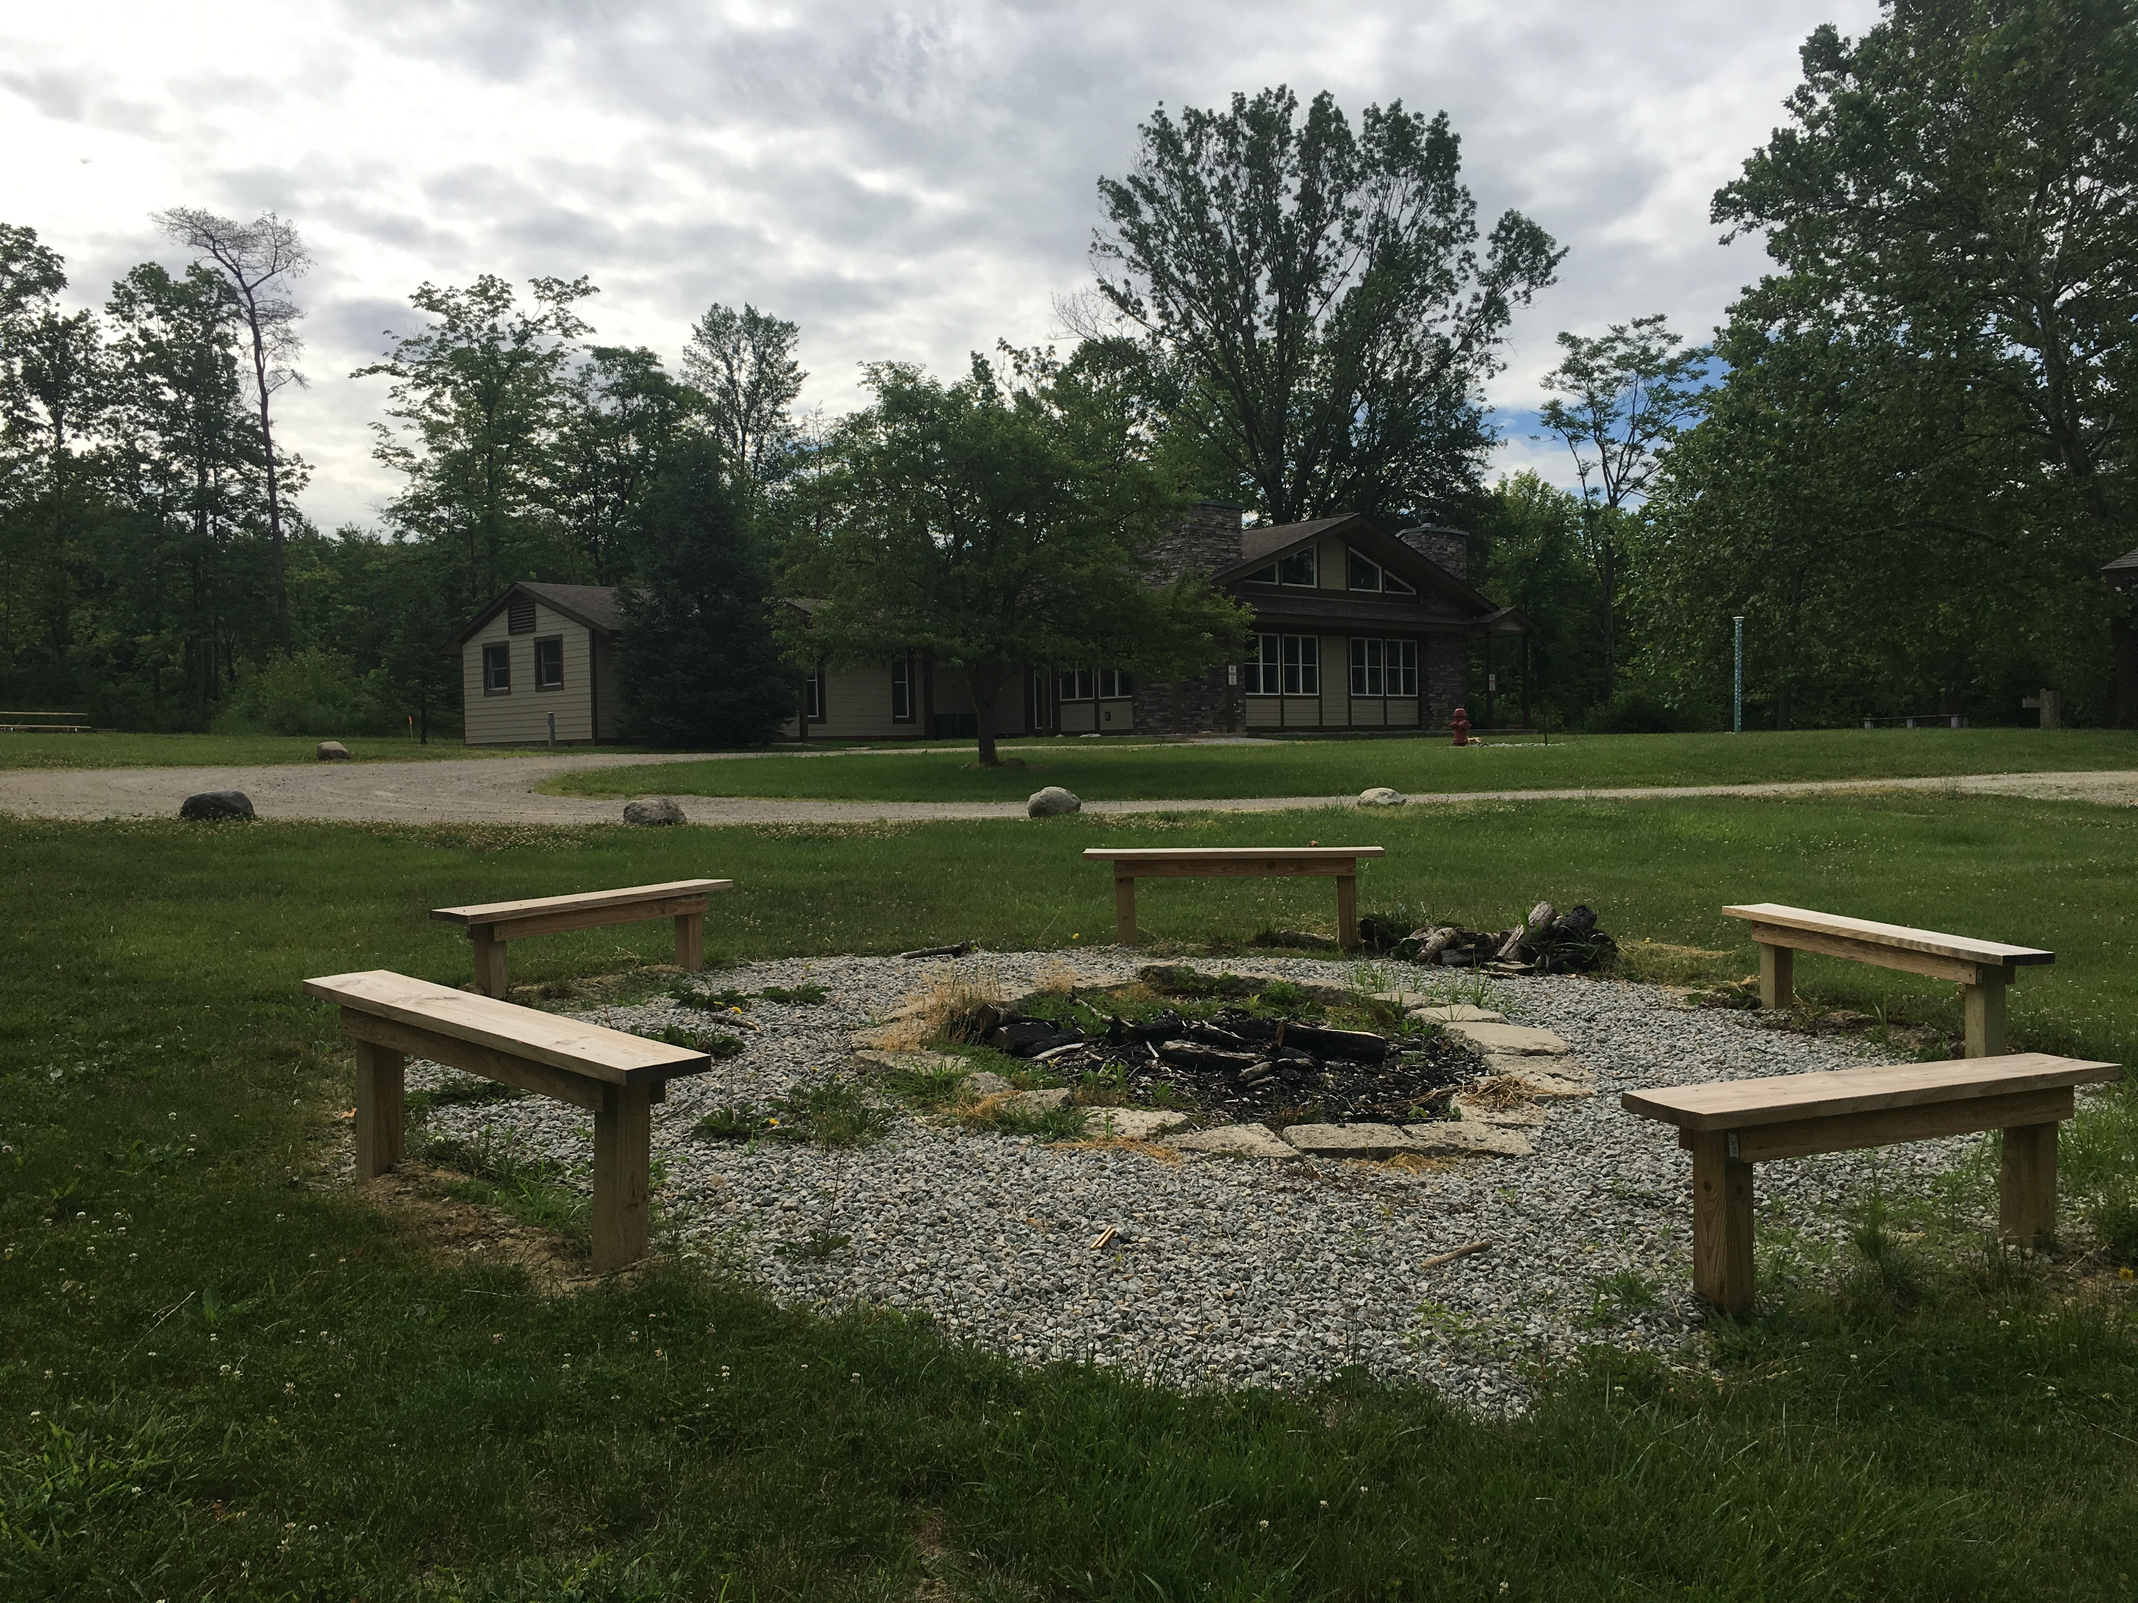
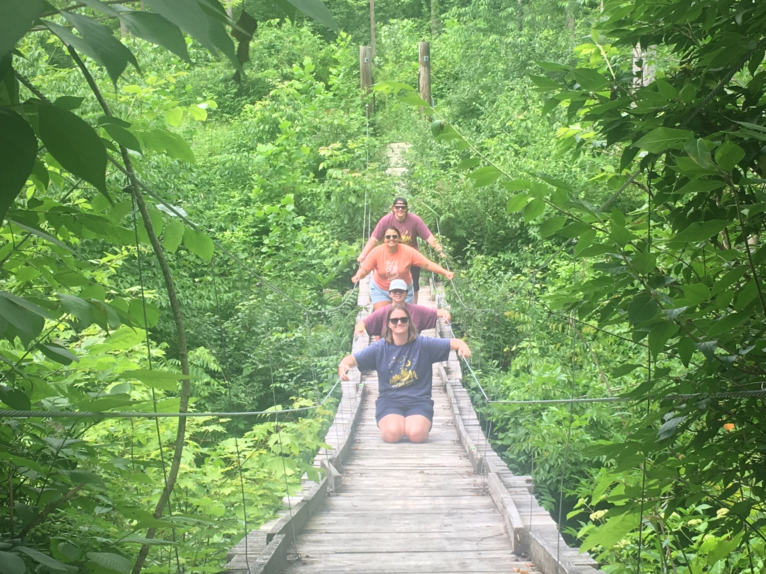
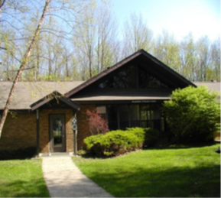
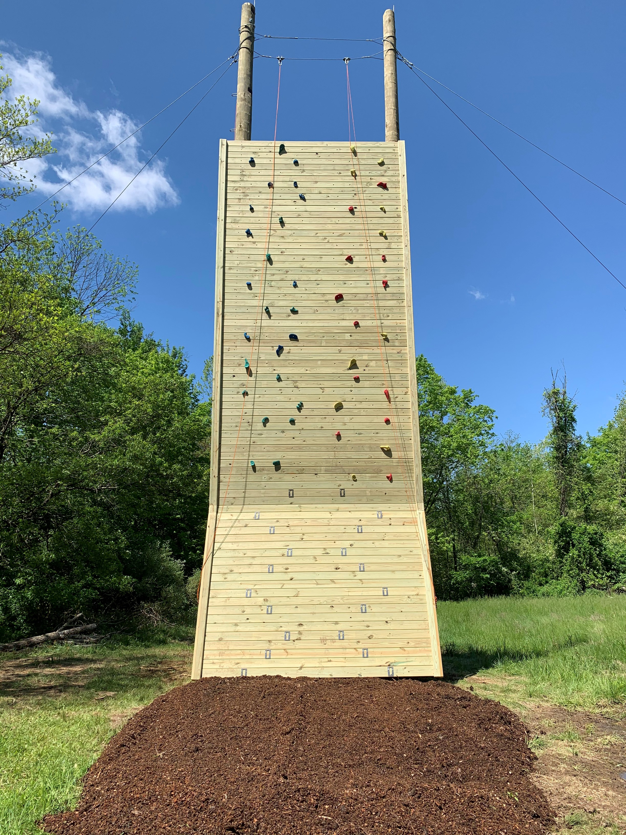
Camp Stonybrook
Open House
June 2
2-4pm
Waynesville, OH
Rustic - latrines in tent units, shared shower house
Accommodations: 4 platform tent units, 2 lodges (split)
Has a climbing wall, low challenge course, archery range, pool, creek and more
Terrain: There's a big hill – you'll have to walk up and down it multiple times per day.
Notes:
Chelsea
Camp Stonybrook is located in Waynesville, about a 45 minute drive from Cincinnati, and 30 minutes from Dayton.
Stonybrook is rustic and has 4 tent units with latrines and 2 split lodges. The pool house bathrooms are always open for troops to use. Stonybrook has a climbing wall, low challenge course, archery range, pool, creek among other things.
The open House at Camp Stonybrook is June 2 from 2-4pm

Slide 8
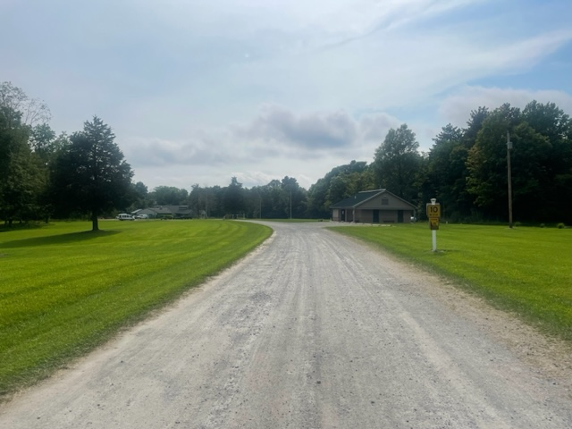
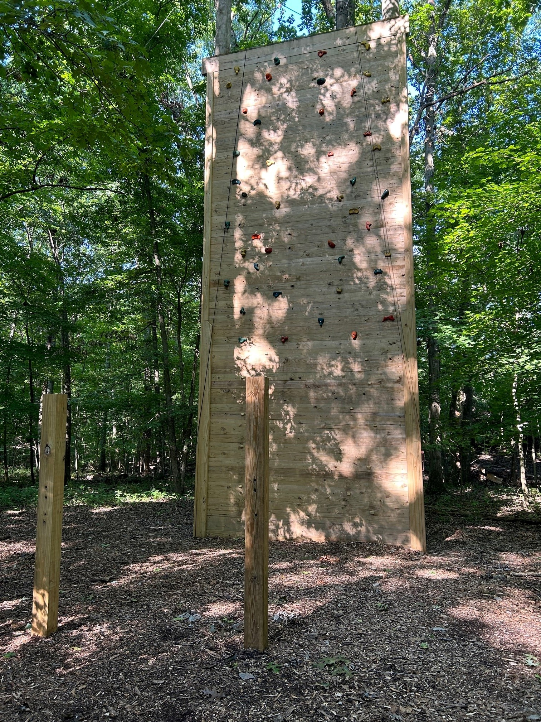
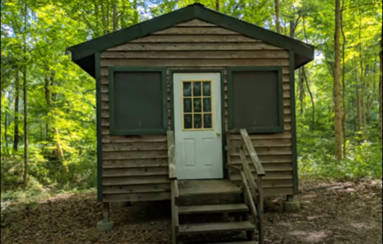
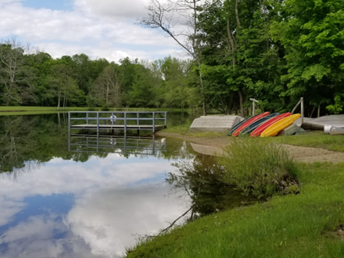
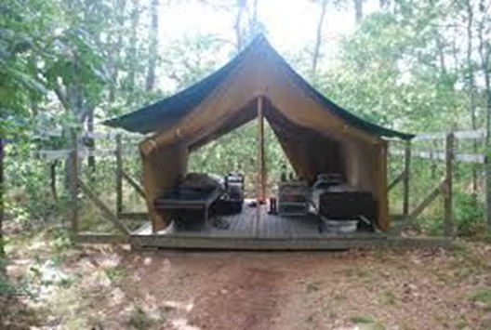
Camp Whip Poor Will
Open House
June 2
1-3pm
Morrow, OH
Rustic – latrines and water troughs in units; 2 shower houses/flushing toilets
Accommodations – platform tents and cabins
Has a climbing wall, high and low challenge course, archery range, lake, pool, new weather station and more
Notes:
Chelsea
Camp Whip Poor Will is considered to be one of our more rustic camps – it has latrines and water troughs or oasis's for hand washing and teeth brushing in the units. There are 2 shower houses – one at the pool and one near the dining hall at the main part of camp. Camp Whip Poor Will has tents and cabins that campers will stay in, as well as some other unique units like the treehouses and covered wagons. It has a climbing wall, high and low challenge course, archery range, lake, pool, new weather station and more.
Each summer camp hosts an open house so anyone who would like to check out camp before their camper attends can see what camp has to offer, ask questions and meet the Camp Directors and staff! The Whip poor Will Open House will be June 2 from 1-3pm.

Slide 9
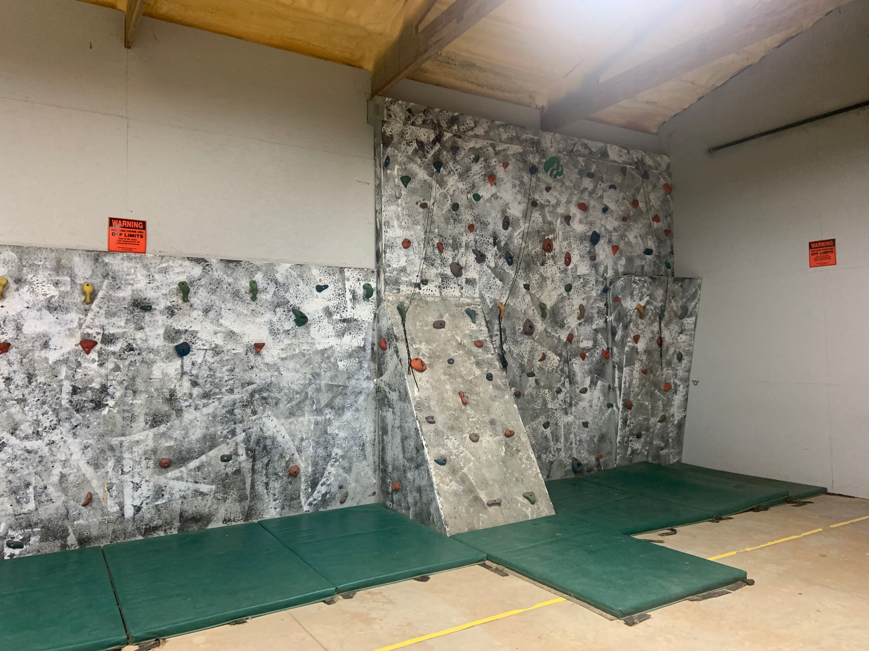
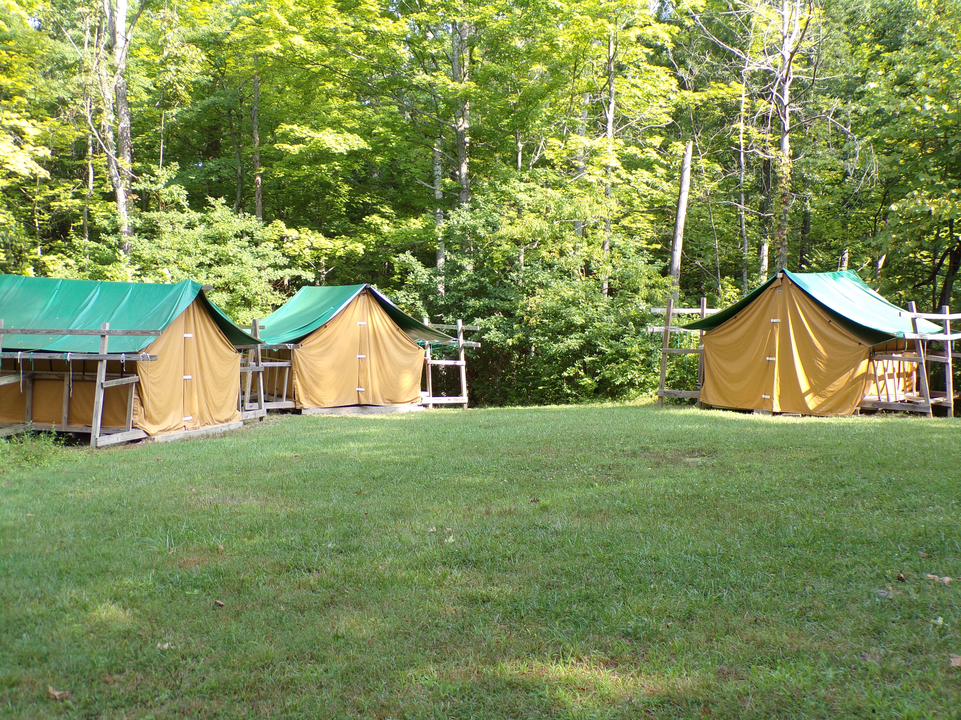
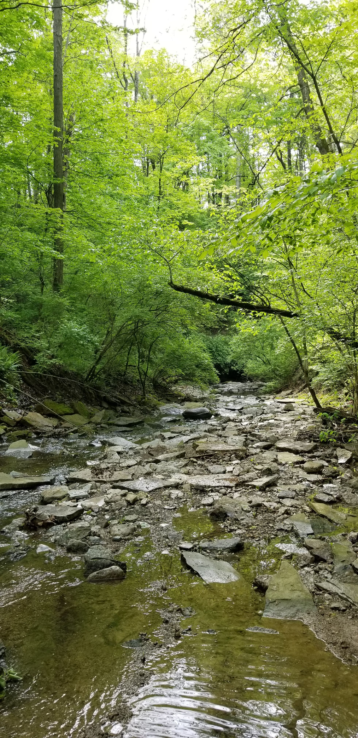
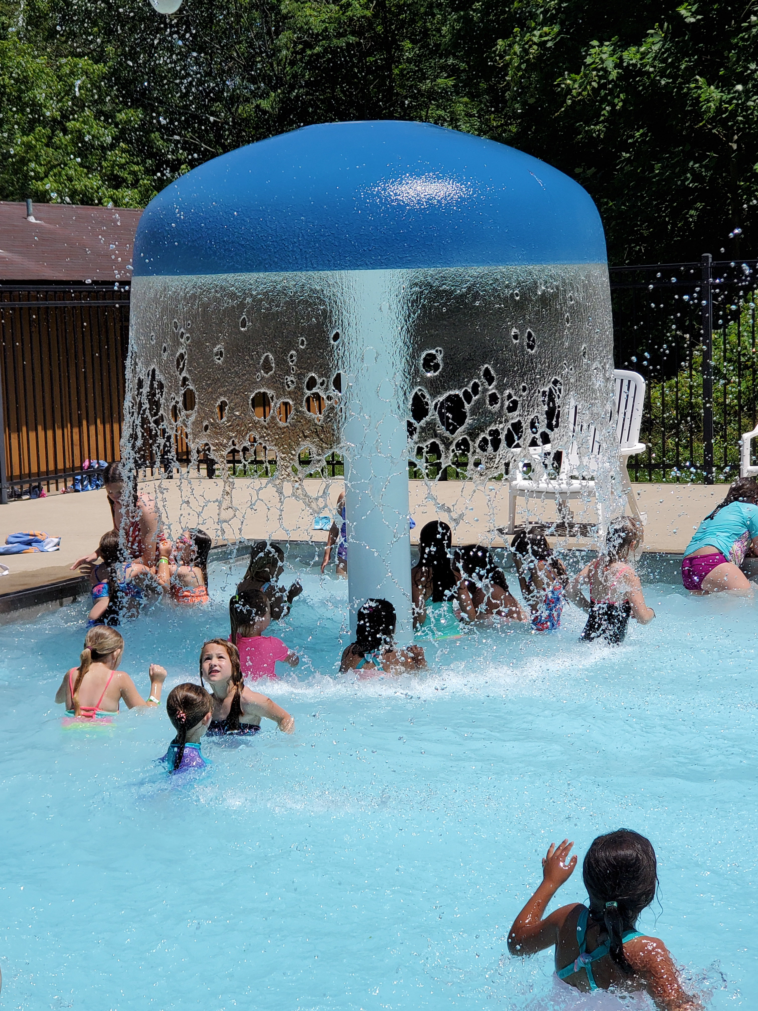
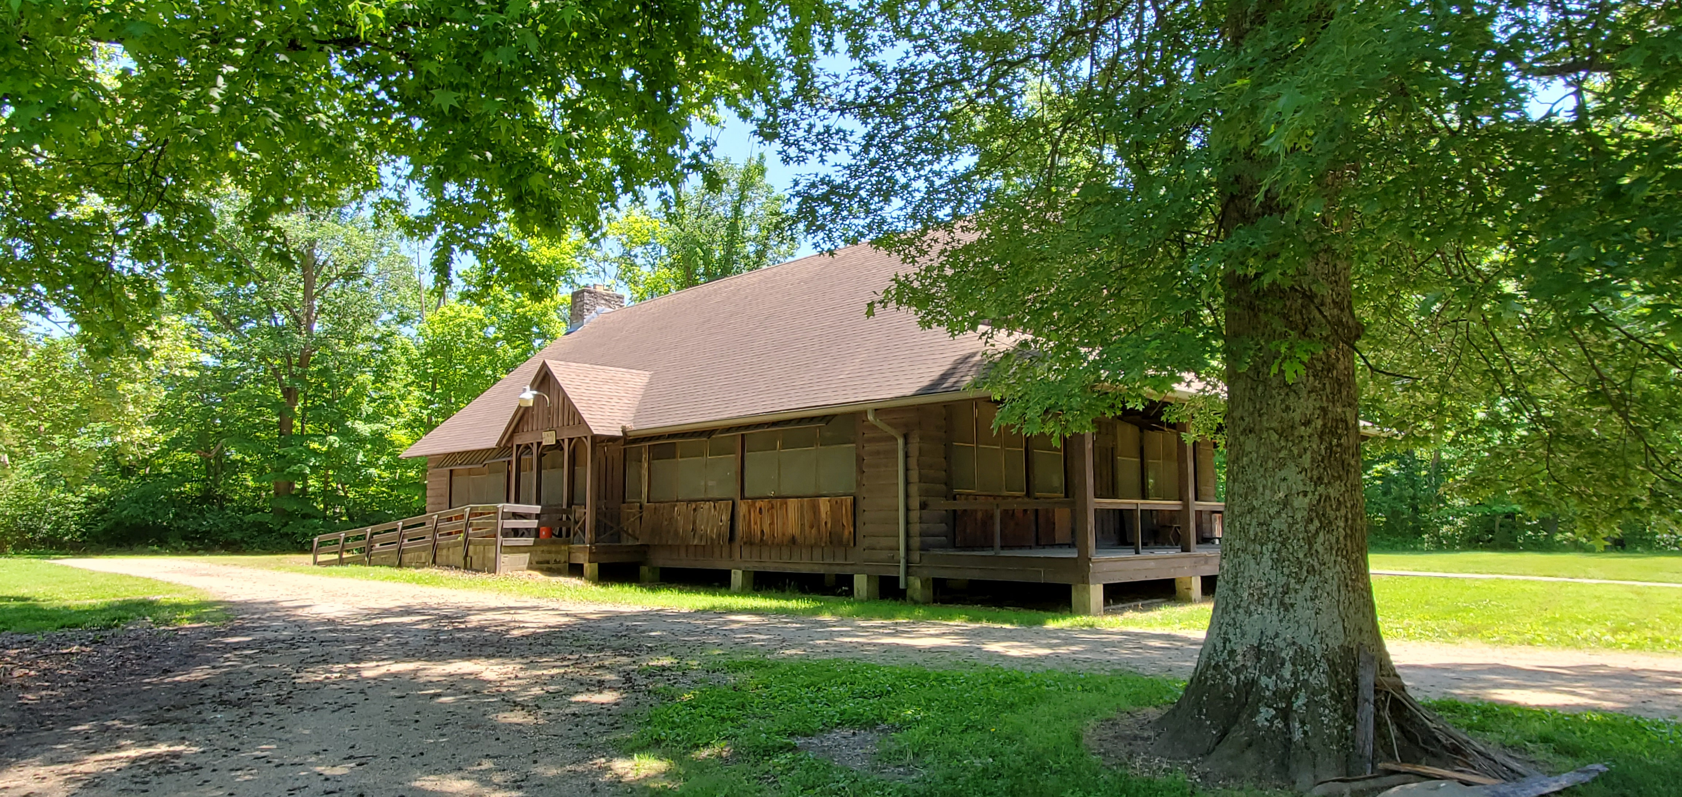
Camp Butterworth
Open House
June 1
2-4pm
Maineville, OH
Shallow pool with water features, small indoor climbing wall, creek, hiking trails, archery barn, Nature’s Playground and more!
Notes:
Chelsea
Camp Butterworth is located in Maineville, which is about 30 min from Cincinnati. It has some great program spaces as you can see in the pictures. It has a shallow pool with water features, small indoor climbing wall, creek, hiking trails, archery barn, Nature’s Playground and much more!
The Camp Open House for Camp Butterworth will be June 1 from 2-4pm.

Slide 10
Summer Camp Opportunities
Notes:
Luna
Alright, so.. At GSWO provide several types of outdoor opportunities, and each offers a unique and somewhat different camping experience. While girls can go to any of these opportunities – not all them may be ready for certain ones.
​
​

Slide 11
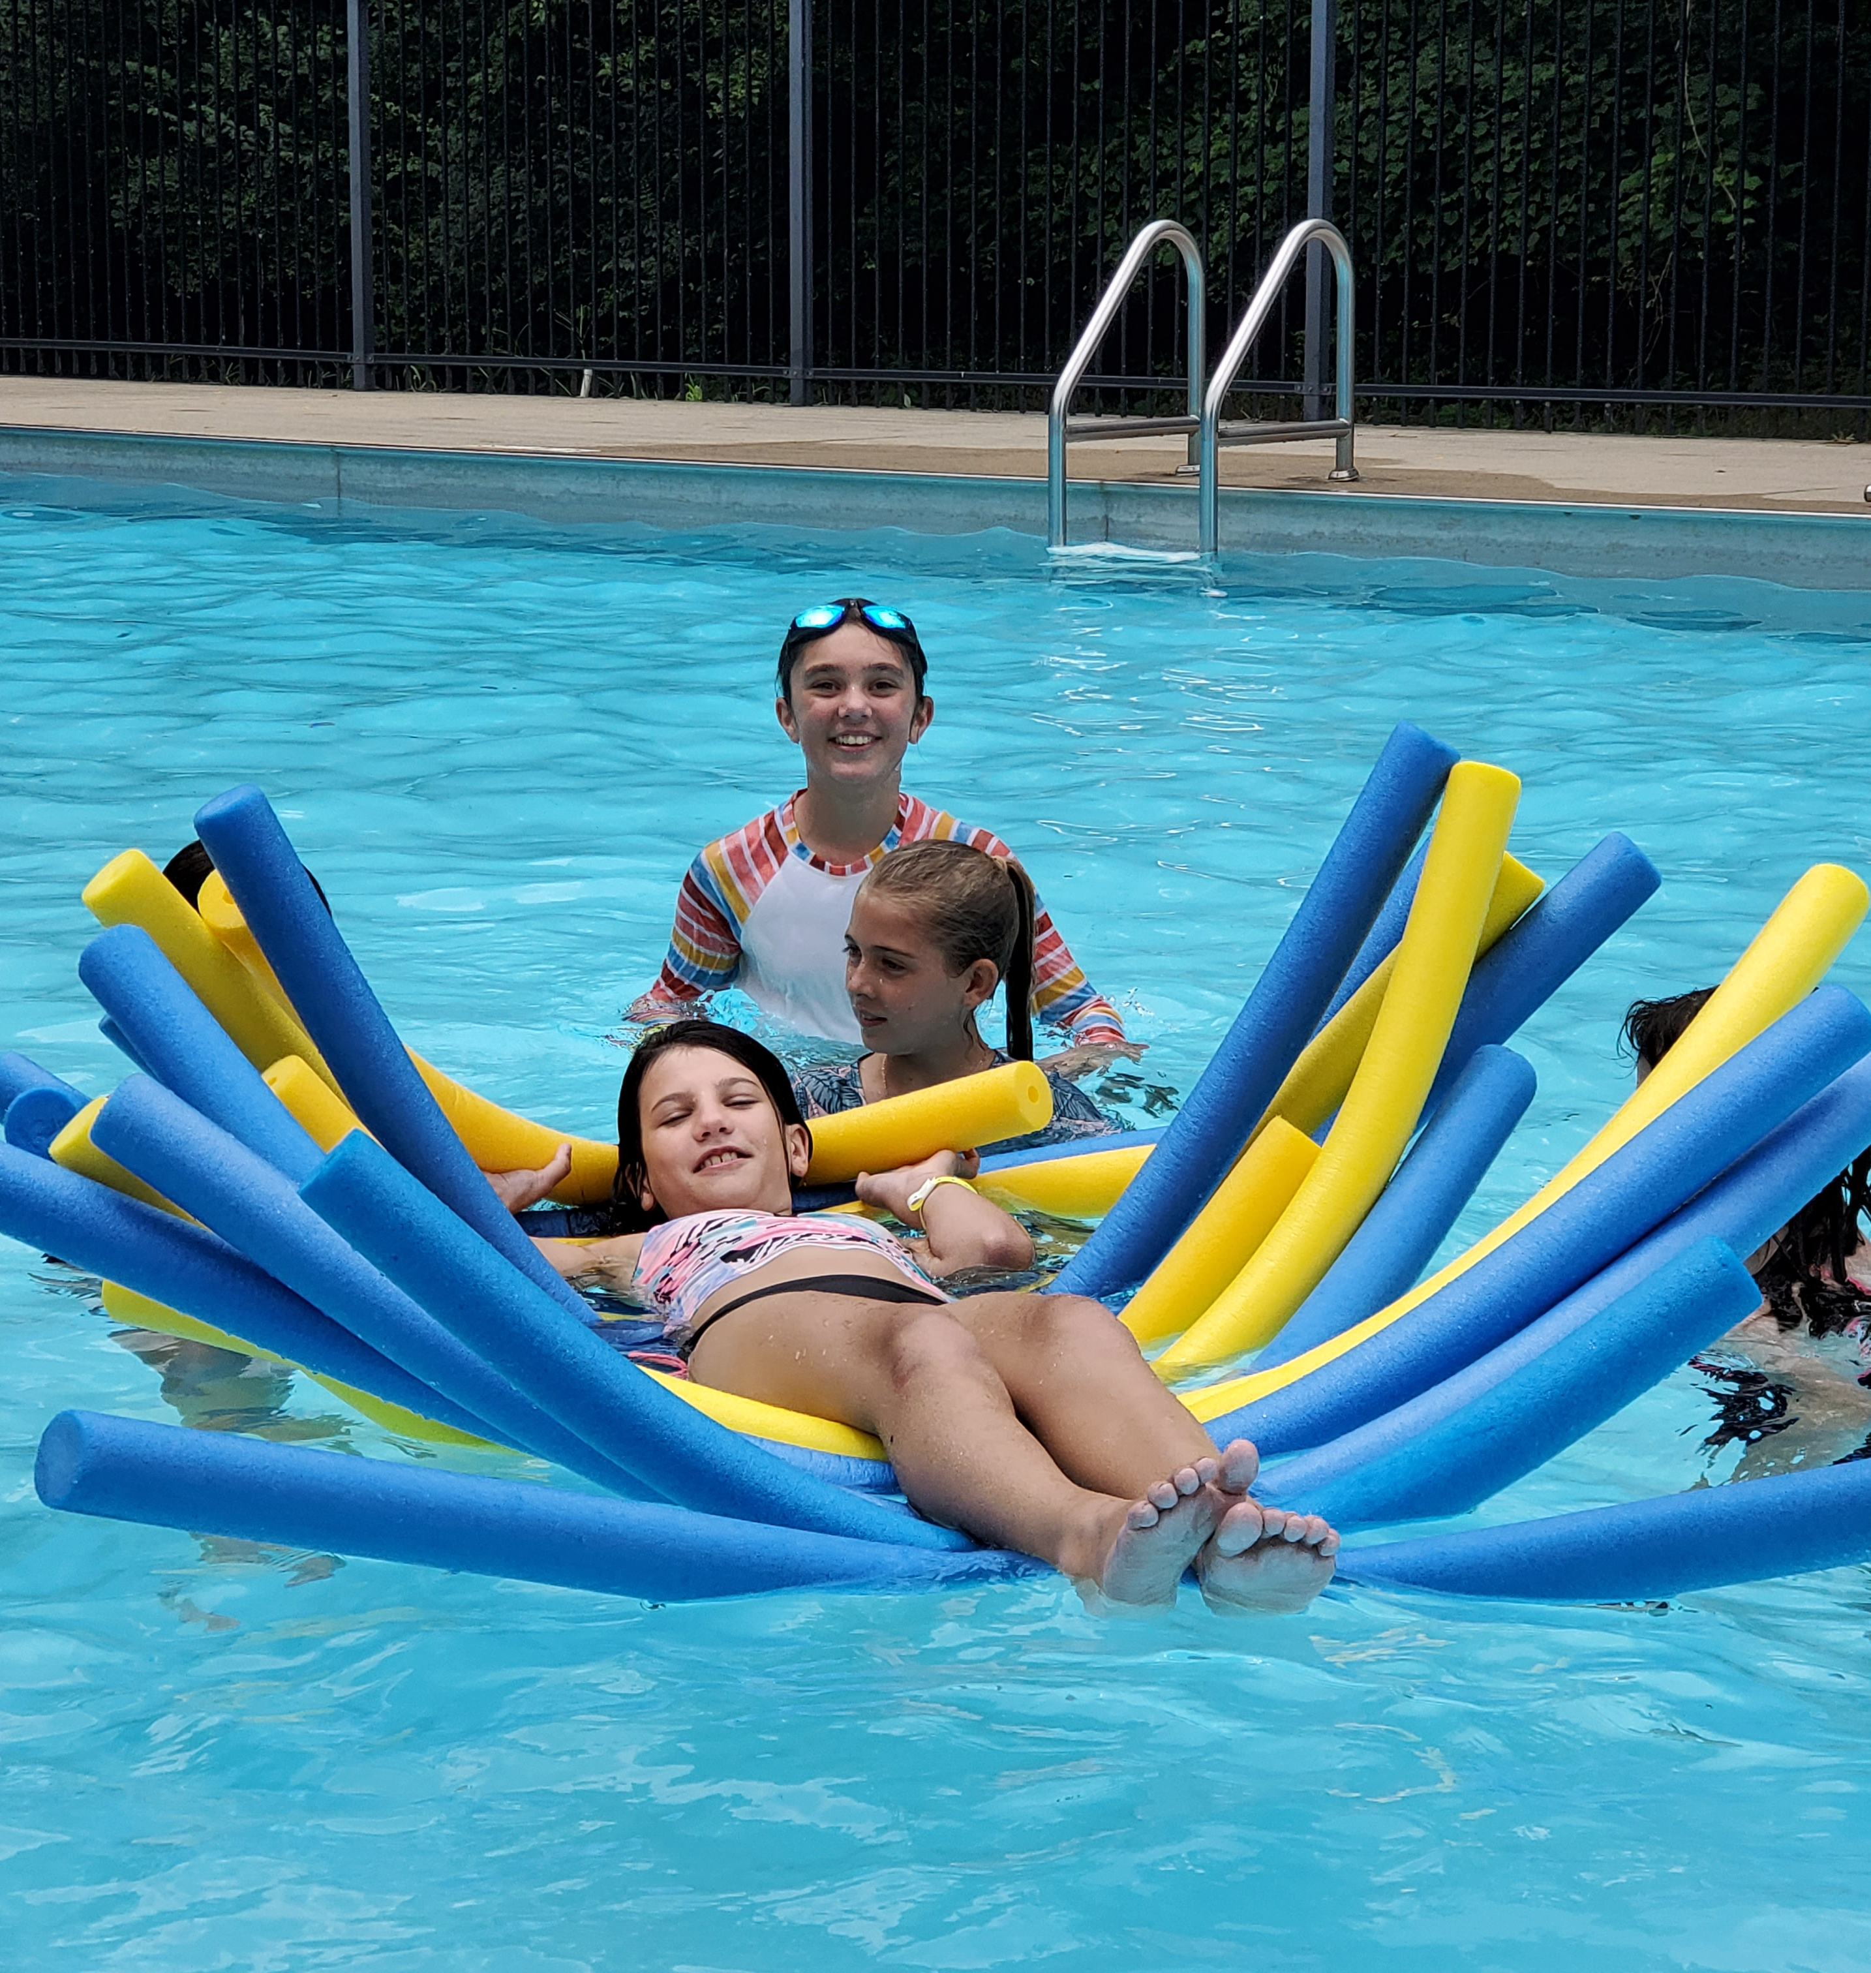
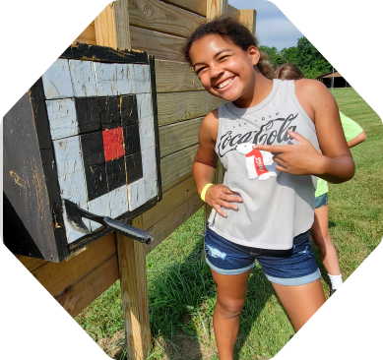
Day Camp - Camp Butterworth
Experience all the fun of camp during the day and return home each evening!
For girls currently in Grades K-7
Optional overnight on Thursday
Different weekly themes for each age level
Girls broken into groups based on age level
Activities such as swimming, hiking, arts and crafts, nature and more
Notes:
Luna
First, we have Day Camp. We run day camp all summer at Camp Butterworth, and we hire our camp staff for the summer and they provide the programming. ​
So, day camps are just that – girls come for the day but go home at night. It's perfect for girls wanting a longer camp experience but still aren’t quite ready to spend the night. We do include an optional one night overnight for the day campers. And campers bring their own sack lunches each day.​
Day camp is for girls currently in grades K-7, with the option for those in 6-7 to be trained as a Program Aide and participate as a Program Assistant, gaining experience working with younger campers. We are also continuing with our Day Camp CIT program this year for high school campers.
This summer at Day Camp, instead of an overall weekly theme, I have changed it up a bit and instead each week the different age levels each have their own themes! But, they will all still participate in activities such as swimming, hiking, arts and crafts, nature, and more.
​
If you are not located in the Cincinnati area, another day camp option for girls are through Volunteer Led Day Camps in their communities. Many service units run their own day camps in the summer using volunteers and older girls to provide programming. More information about these can be found on the Camp Website.

Slide 12
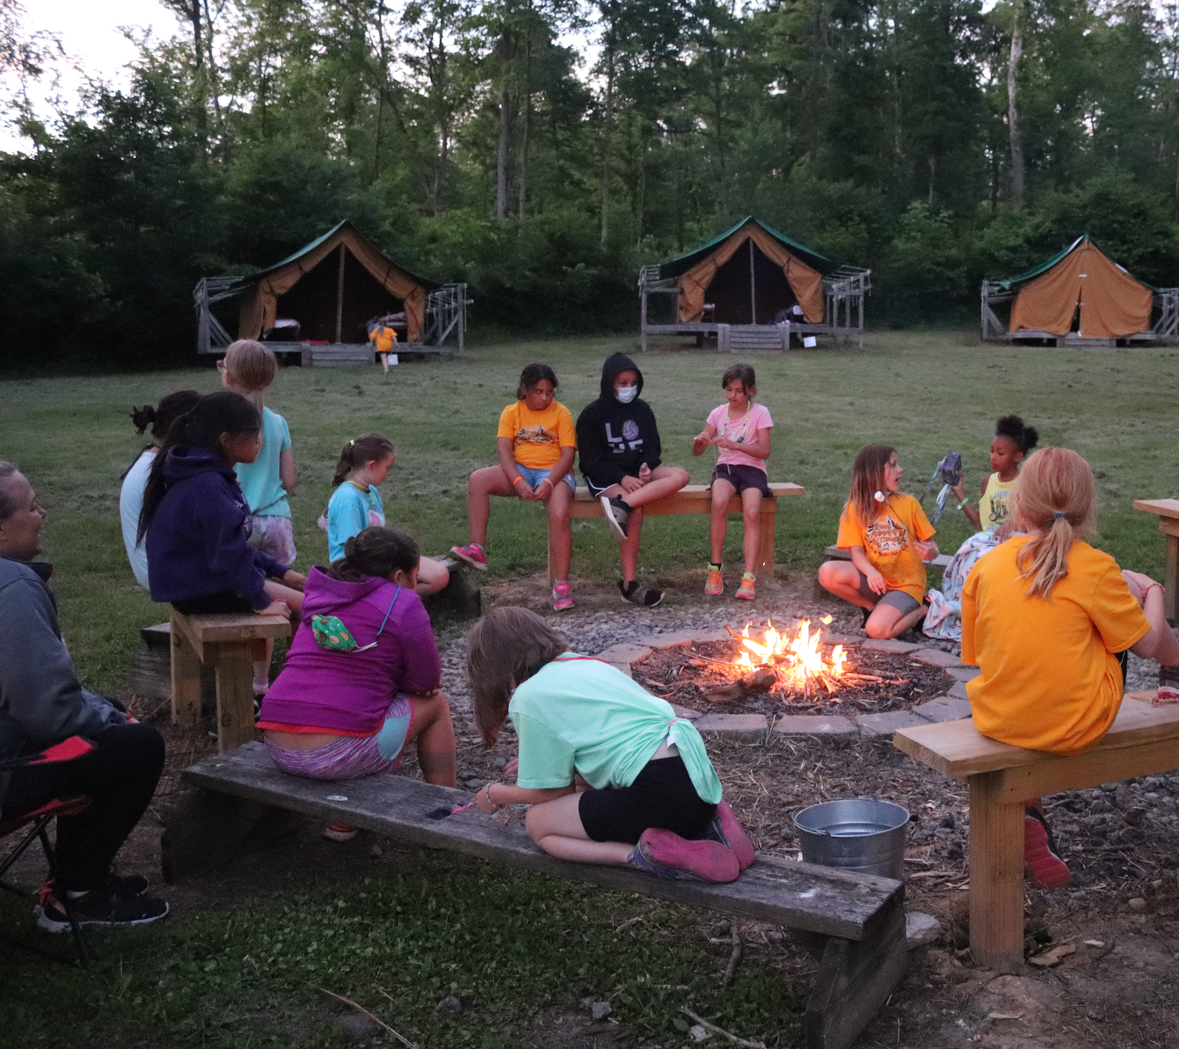
Troop Adventure Camp
Girls attend camp with their whole troop with camp staff support.
For girls currently in K-8, girls in 9-11 can be a JI and volunteer at camp
Troop leaders provide ratio, supervision, first aid etc...
Camp provides meals and programming
Troops pick 7-12 activities from a list of 40+ options, staff and JI's facilitate (pool time is automatic!)
Tent and lodge options
Share unit with a sister troop
JotForm registration - camp.gswo.org/TAC
Troop Trips & Travel module required
Notes:
Chelsea
The next step in our summer camp progression is Troop adventure camp or “TAC)​
TAC is awesome for girls wanting to go to overnight camp but who might still need some support. ​
As the name suggests, girls attend camp as a troop with their troop leaders and other adult volunteers. ​
Troop leaders provide ratio/supervision first aid and all that good stuff – adults have to be gs approved volunteers
Each group needs to follow ratio as outlined in safety activity checkpoints, so at least two adults need to attend – these required adults attend TAC free of charge.
Leaders are required to take Safety Beyond the Troop training before going anywhere outside their normal meeting place, including attending TAC. This short training can be taken online as a myGS training module here. We find that troop leaders that attend camp with this foundation have a much better understanding of some of the policies that we follow at camp (First aiders etc...).
Troops can stay in lodges or tents, but daisies and brownies get priority for lodges. ​Troops can also elect to bring their own pop-up tents.
Troops pick their programs from a menu of 40 + options. These programs are ran by the camp staff​ - this list can be found on the website now – the pool is automatic and doesn't count against their activities. Already built in.
In addition, troops get to participate in in camp activities like counselor hunts, themed meals and campfire programs. ​

Slide 13
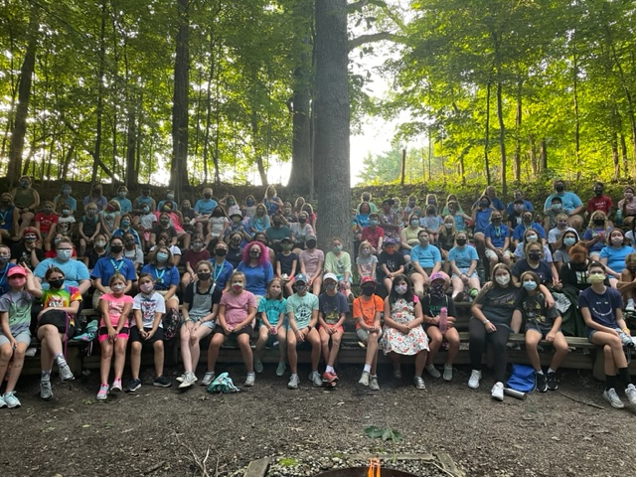
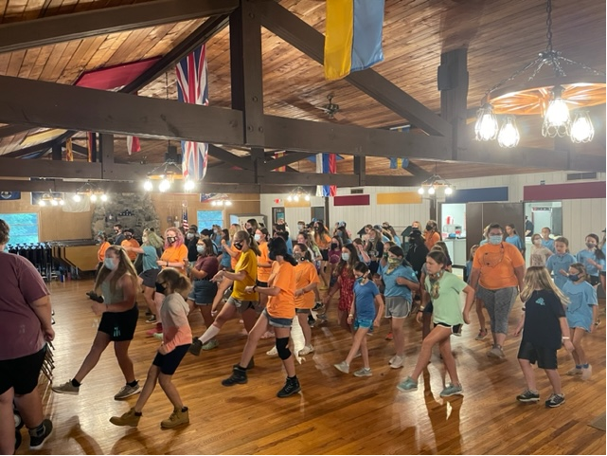
Overnight Camp ​
Experience all the fun of overnight camp with new friends! ​
For girls currently in Grades K-11
Mini Session (3 days/2 nights) or Full Session (6 days/ 5 nights)
Girls broken into groups based on age level​ and theme
Session themes vary from art, nature, STEM, high adventure and more
Activities such as swimming, hiking, arts and crafts, nature, star gazing, climbing wall and more​
Notes:
Tori
Our last steps of camp progression happen at overnight camp! Overnight camp is an experience where girls can attend camp by themselves or with a buddy and stay at camp for 2 nights or 5 nights. Girls currently in grades K-11 can attend and are in groups based on age level. Each program session has a theme with a description that lists activities they can expect to do while at camp, some of which you can see listed here. The descriptions for sessions can be found on the camp website.

Slide 14
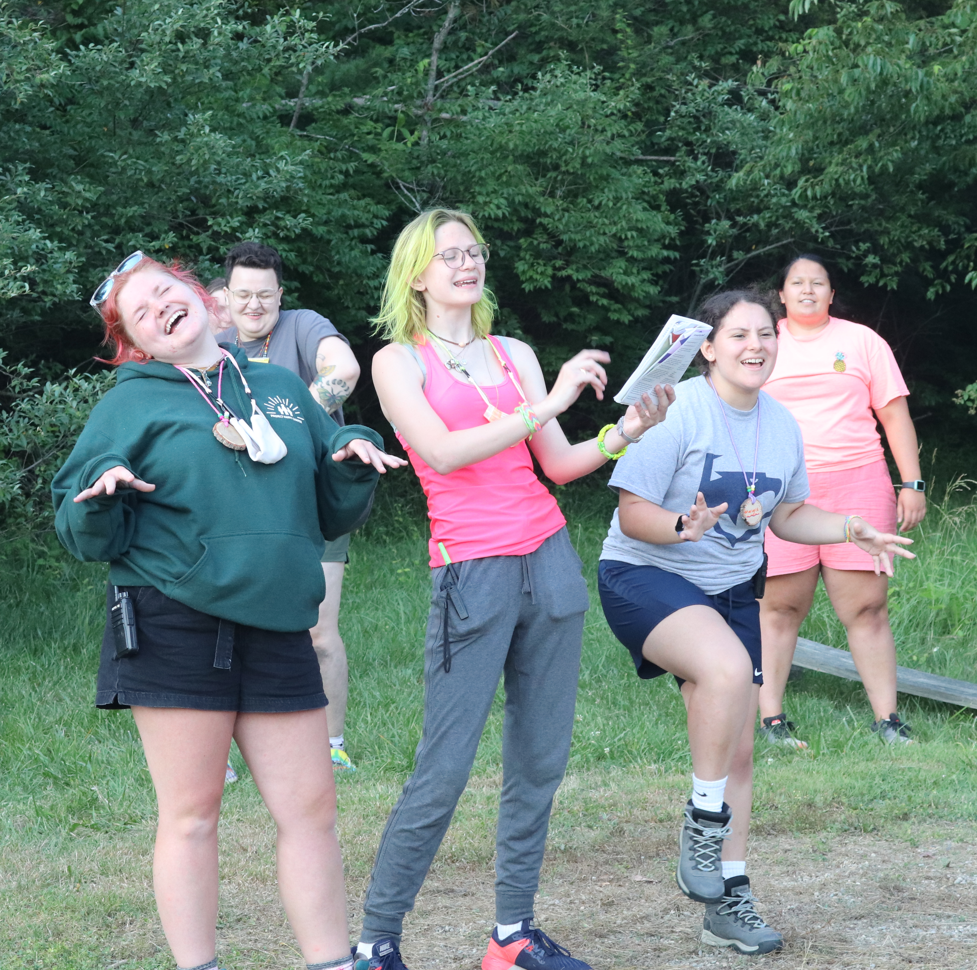
Older Girl Leadership Opportunities
Day Camp:
Program Aide Training
Program Assistant
Day Camp Counselor-in-Training
Troop Adventure Camp:
Junior Instructor
OvernightCamp:
Counselor-in-Training 1
Counselor-in-Training 2
Junior Counselor
Notes:
Luna​
We offer great older girl leadership opportunities at our camps.
At Butterworth
PA TRAINING
Girls currently in 6-7th grade can attend Program Aide Training; the LiA award is a pre-requisite for PA training. Girls can get PA trained in a variety of ways – through their service unit, they can attend a PA training event hosted by the Girl Scout program team or attend PA training at camp. If they sign up during camp, they will spend part of their week in training learning how to work with younger campers, and part of the week helping out in units with a younger group. They are dropped off and picked up from camp each day.
PROGRAM ASSISTANT
Girls that have already been program aide trained can attend Butterworth Day Camp as a Program Assistant. They are dropped off and picked up each day like the campers, but help out with the different programs.
Day Camp CIT
Is for currently in 8-11 grade. This is great for girls who still want to be able to come to camp, but are ready for a bigger Leadership role as they get older. In this program they will learn about age-level characteristics, the GSLE, learn how to and practice leading activites with the campers, and get to learn about what it means to be a Day Camp Counselor!
Junior Instructors are used at Stonybrook and Libbey for TAC; they lead the different activities for the troops throughout the session.​
​
At overnight camp at both Libbey and Whip Poor Will we have the Counselor-in-Training program.​
Counselor-in-Training I is for girls going into grades 10-12. This is a two week opportunity where girls spend time with the CIT Director learning about the GSLE, girl age level characteristics, and how to lead programs.​
Counselor-in-Training II is for girls going into grades 11-12 who have completed CIT I. This is also a two-week opportunity where the girls spend the first week building on the skills they learned in CIT I. The second week girls are assigned to a younger girl camp session and they work with that group from breakfast to bedtime each day and spend one night sleeping in a unit with girls like a counselor would. They also will have the opportunity to shadow our specialty positions as well as work with an assigned program session.​
CITs do go home on the weekends between their sessions.
After they have completed CIT 1 and 2, girls going into the 12 grade can apply to be a Junior Counselor. They attend a 3 day training before camp starts and then complete at least one internship week at both Camp Whip Poor Will and Camp Libbey. ​

Slide 16
Allows caregivers to fill out forms once for all council sponsored programs. ​
If campers return for summer 2023 parents will only have to update information . ​
​Adults may have to skip some areas – put N/A or leave blank anything that doesn’t relate to you
Notes:
Luna – can you do a demo???

Slide 17
Setting your Camper up for Success
Notes:
Talk about things like
Talking about missing home – totally normal – please don’t tell your kids you will pick them up! Will create upset campers at camp.
What are some other things they can do – write letters, bring a bear (have caregivers send letters each day etc…)
Spend the night away from home
Practice using flash lights
Practice night time routine
Night time sounds at camp
Trying new things
No phone policy

Slide 19
Packing for Camp
Notes:
Talk about
Campers packing own stuff
Packing in a tote vs. a bag
Labeling everything etc…

Slide 21
Balance Due
Notes:
To view and pay the balance due, log into MyGS. The balance due can be paid by credit card and also by cash, check or Digital Dough by mail, or delivered in person to a regional service center. The balance of all camps must be paid IN FULL by May 1.
To ensure fair and timely registration of all campers, registrations submitted without the appropriate forms completed and/or proper fee included will not be accepted and will be returned. If the balance is not paid by May 15, your reservation will be canceled and your deposit forfeited. Each camp registration form submitted on or after May 1, must include payment in full for each camp program.
Financial assistance – https://form.jotform.com/210387138738058
Girls should not be turned away when she has a desire to discover new things, connect with other girls, and make the world a better place. If you need financial assistance to attend summer camp, we're here to help!
Complete the form below and we'll contact you as soon as we've awarded your financial assistance!
Digital Dough - https://www.gswo.org/en/members/for-girl-scouts/for-cookie-sellers/digital-dough.html

Slide 23
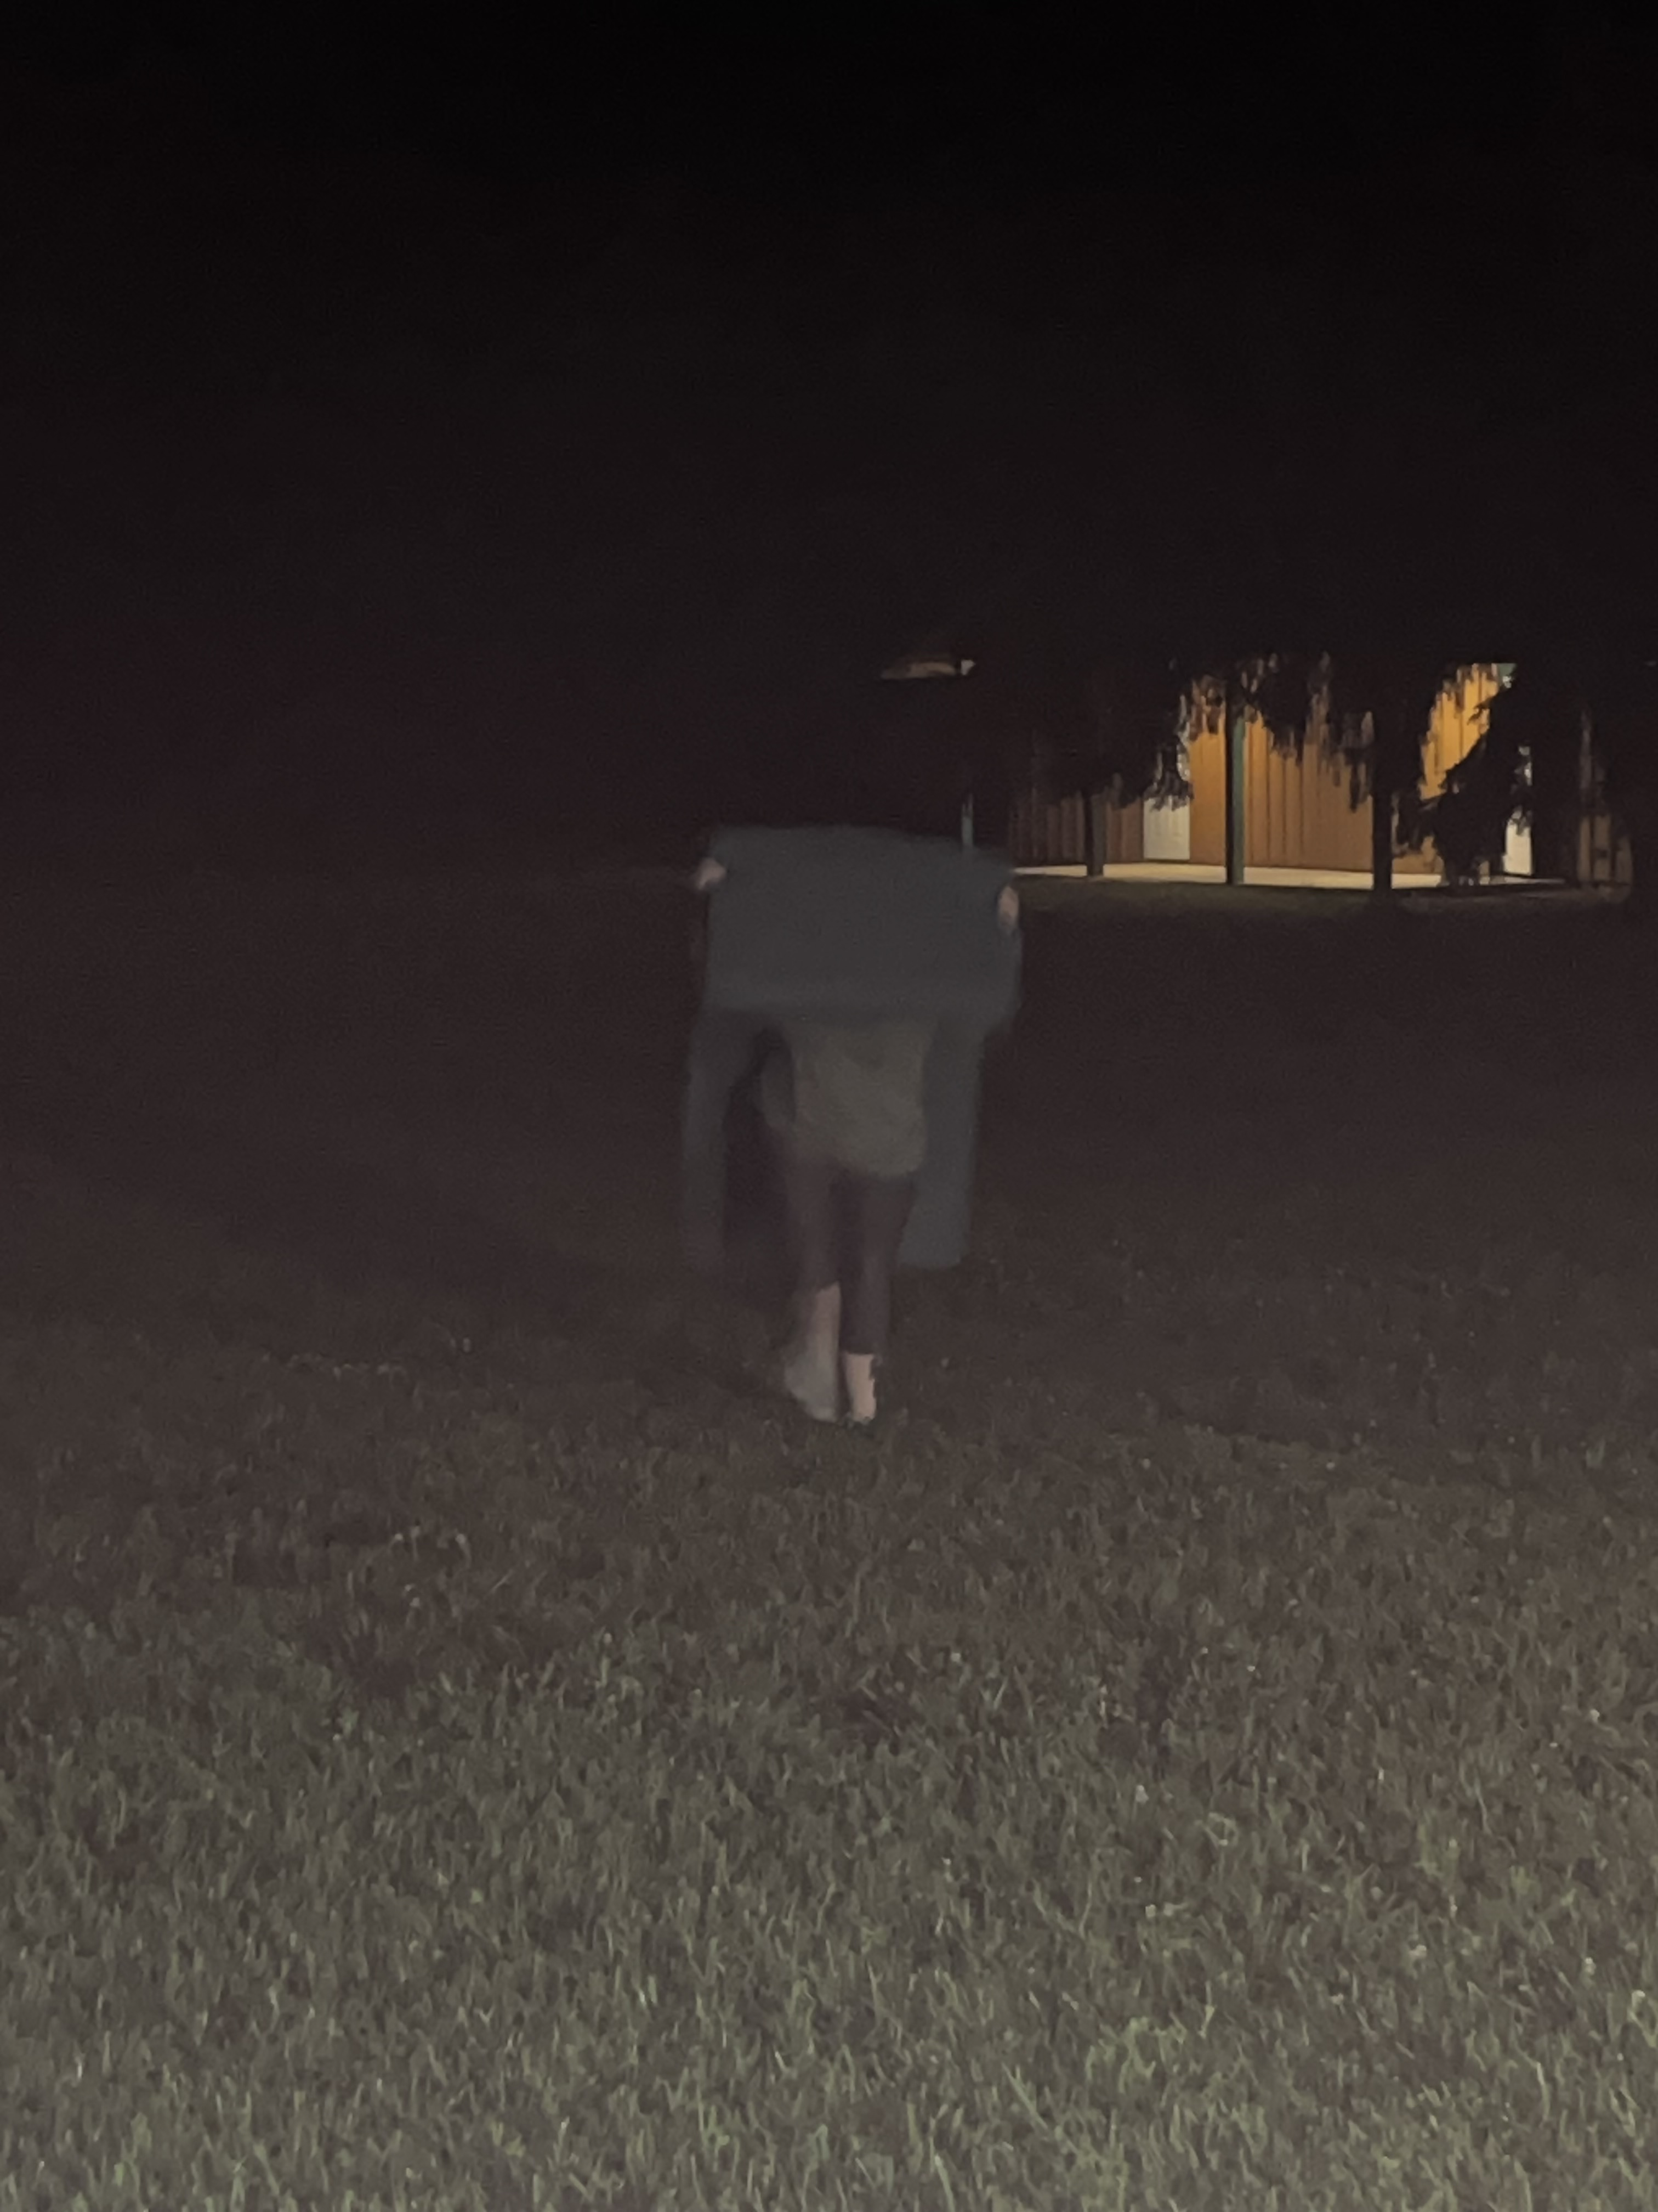
Questions?
Notes:
Tori? anyone?

